Slide 1
ZS Hackathon
Harshit Khandelwal

Slide 2
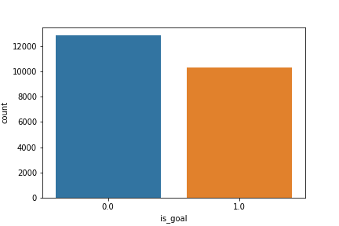
WINS VS LOSSES

Slide 3
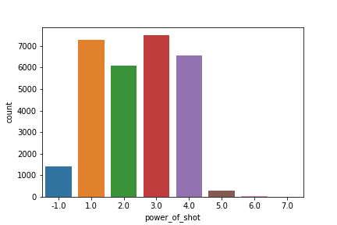
The Power behind the shot

Slide 4
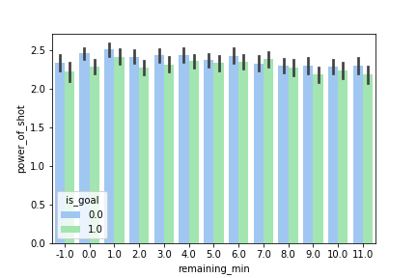
How Power changes with time remaining

Slide 5
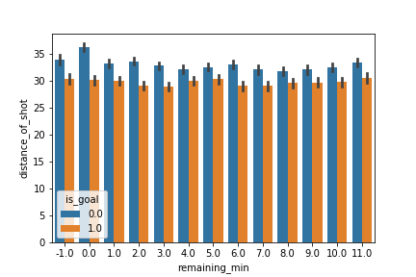
The distance with time

Slide 6
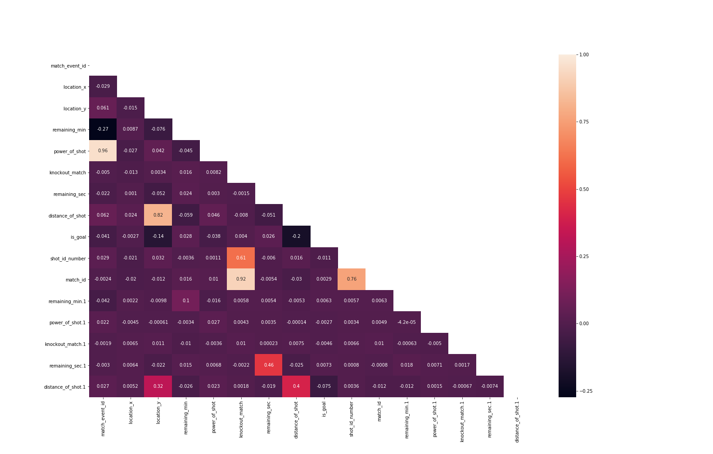
Correlation change
Initial Correlation

Slide 7
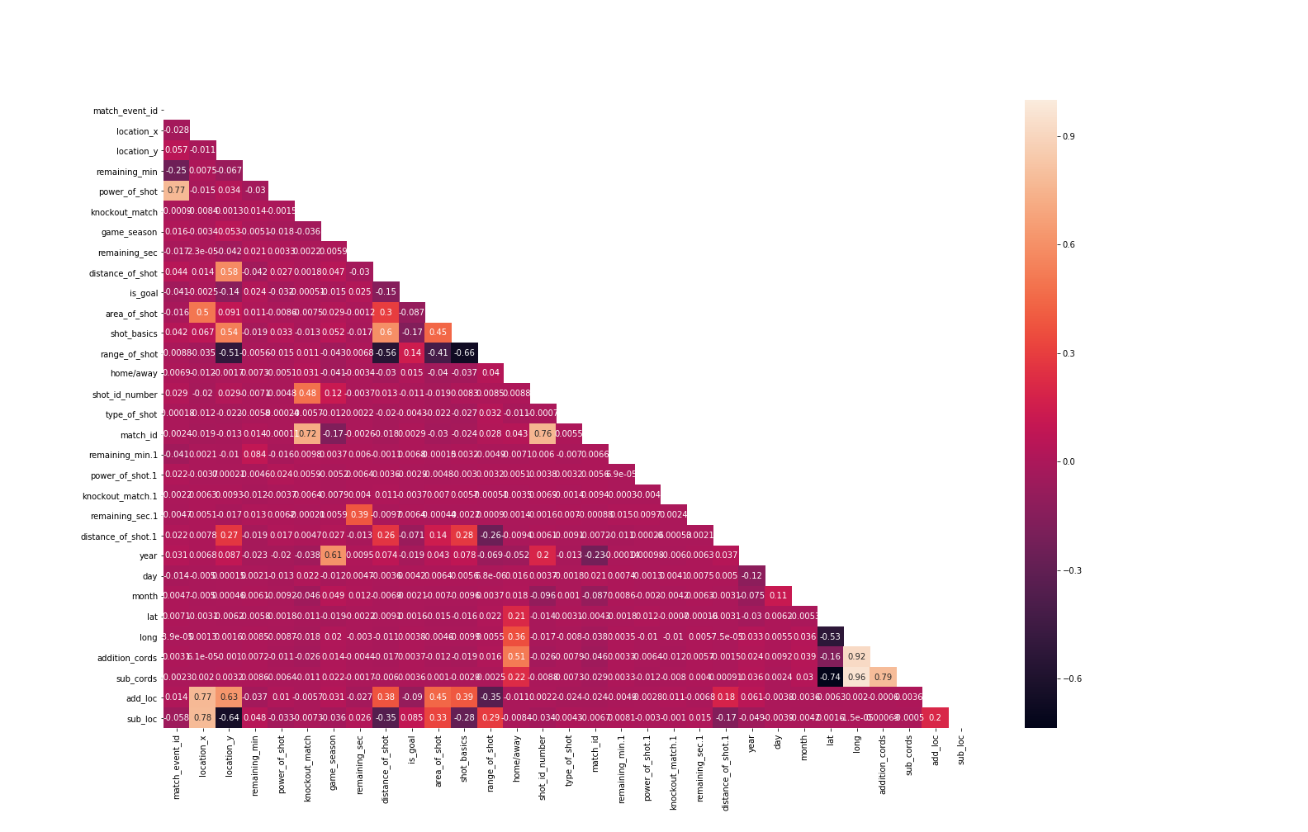
Final Correlation – After all the cleaning

Slide 8
Thank you

